Slide 1
Software Architecture Design Space

Slide 2
Lecture Objective
Introduce major perspectives on, and structures used in, software architecture
Introduce major element and connector types used in software architecture
Introduce the iterative refinement process for software architecture design

Slide 3

2.1 Overview
Software Architect must understand the Software design space
Best support the detail design and implementation of a project.
Design alternative which best support Functional Requirements & NFR
In its simplest form, a software architecture design is a set of software elements connected by a set of connectors.
A software element can be a process, an object, an instance of a software component, or a service. [Dynamic view]
a software element can be a package, a class, a component, or a loadable library. Correspondingly, a connector can be an import clause, inheritance clause, interface specification, pipe, or filter [dynamic]
Notes:
An architectural pattern is a general, reusable solution to a commonly occurring problem in software architecture within a given context

Slide 4

Overview
Different software elements may run on different hardware and software platforms
may be implemented in different programming languages or
on different software frameworks.
Two software elements can run in the same process,
on the same computer system, within an intranet, or distributed over the Internet.

Slide 5
Overview
Depending on their relative location,
the connectors between a pair of software elements can be implemented in various forms including
local method invocations,
remote method invocations,
service calls,
and messaging through message queue.
The connectors can also work in synchronous or asynchronous nodes.

Slide 6
2.2 Types of Software Structure
Types o Software Structures
Static Structure
Software Runtime Structure
Software Management Structure

Slide 7
Types of Software Structure
2.2.1 Static Structure
A software architecture design can be described with various software structures, each from a different perspective.
It may be described in terms of software code units like source/binary code files, software modules, or software component deployment units; this is known as the static structure.
2.2.2 Dynamic Structure
It may also be described based on the runtime dynamic structure, in which the software elements are threads, processes, sessions, transactions, objects, or software component instances at execution
time.

Slide 8
Types of Software Structure
2.2.3Management Structure
Furthermore, an allocation structure may also be used to describe the project management structure of an architecture design.
These different types of structures use different connector types and different performance attributes.

Slide 9
2.2.1 Software Static Structure Detail
A software project is typically implemented in multiple files.
This includes static file types such as
executable files;
library files binary
software component modules (usually in the form of DLLs [dynamic linking libraries], JavaBeans, and Enterprise JavaBeans);
deployment descriptors; and other resource files.
Notes:
A Java Bean is defined as an instance of a class that contains private attributes (data), and getter & setter methods.
An EJB (Enterprise Java Bean) is much more complex They only reside in application servers that handle EJBs (Tomcat doesn't hold EJBs).

Slide 10
Software Static Structure
At software development time, the main software elements are source code modules or files. Each module has assigned functional
and nonfunctional attributes, and the public APIs (application programming interfaces), defined for each module separate the module's
interfaces and implementations. The connectors at this level are module dependent. Module A is connected to module B if, and only if,
A needs to invoke some methods in B during execution. Such connectors may exhibit the following attributes:

Slide 11
Software Static Structure
Direction: If module A invokes a method of module B during execution, there is a unidirectional connector from module A to module B.
Synchronization: A method invocation can be synchronous or asynchronous.
Sequence: Some connectors must be used in a particular sequence.

Slide 12
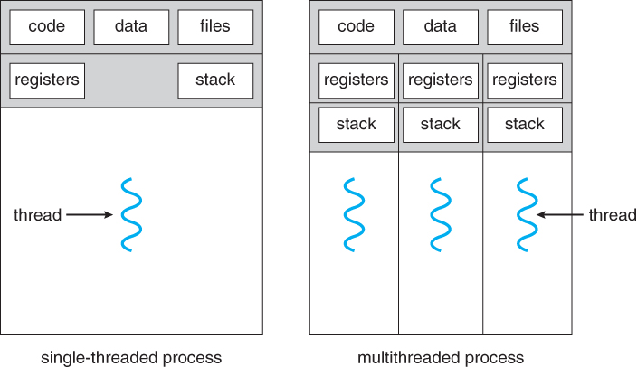
2.2.2 Software Runtime Structure in detail
At runtime a project consists of one or more
threads,
processes,
functional units,
and data units.
These elements may run
on the same computer or
on multiple computers
across a network

Slide 13
Software Runtime Structure in detail
The same element in a code structure may implement or support multiple runtime
elements. For example, in a client-server application, the same client module may run on many client computers. Conversely, several
code structure elements may implement or support a single runtime element. For example, many threads will run multiple methods from
different classes that maybe packaged in different code units.

Slide 14
Software Runtime Structure in detail
The connectors at this level inherit attributes from their source-code structure counterparts, along with the following other attributes:
Multiplicity: One element can be connected to multiple elements if it needs to invoke methods of multiple elements at runtime.
Distance and connection media: Two connected elements may communicate in the same thread, in the same process, on the same computer, or on different computers across a network. Based on the distance between two elements, the communication media may vary from copper/optical cable or wireless based LAN to the Internet

Slide 15
Software Runtime Structure in detail
Universally invocable: A connector with this attribute set to true allows any external software system, no matter what hardware/ software platforms they run on and in which programming languages or software frameworks they are developed, to invoke the method at the connector's target.
This attribute is critical for heterogeneous enterprise information systems that must be integrated efficiently.

Slide 16
Software Runtime Structure in detail
Self-descriptive: A connector with this attribute set to true can allow an external software system to invoke its target method without the pre-installation of any software specific to the method.
This attribute allows clients to choose service providers dynamically. It also allows software systems developed at different companies at potentially different times to dynamically interact with each other.
For example, agents from different companies may be able to collaborate without special software installation.

Slide 17
2.2.3 Software Management Structure in detail
A large software project is normally designed and implemented by several project teams, each having its well-defined responsibilities at specific SDLC process stages.
At this level, each element consists of manipulation (design, implementation, debugging, etc.) of specific code units assigned to each project team, and the connectors are derived from runtime dependency among the code units and software process dependencies.

